Slide 1
Temperature and Gas Detector
DHT11 and MQ-135
Vince Bengco
Demier Muangsopa

Slide 2
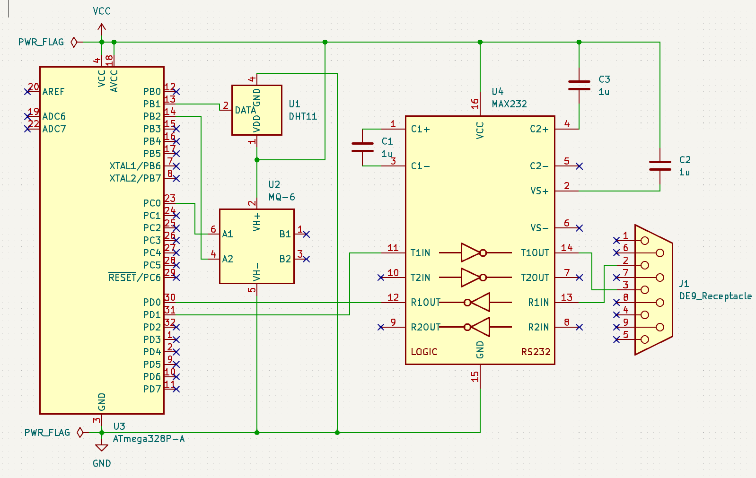
Project
(Mq6 in substitute for mq135)
For our design, we implemented a cost-effective temperature and gas detector.
The purpose of this device is intended to be used for enclosed spaces that may be exposed to dangerous chemicals in the air and display its reading, along with a useful temperature and humidity gauge.
Some of the key components for this project include:
ATmega328P microcontroller
DHT11
MQ-135
Capacitors
MAX232N
USB to RS232 cable

Slide 3
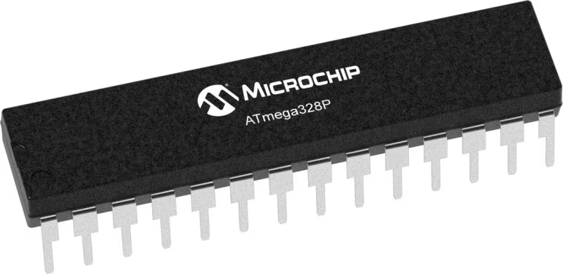
Hardware: ATmega328P Microcontroller
From Atmel’s instruction data sheet:
The Atmel® picoPower® ATmega328P is a low-power CMOS 8-bit microcontroller based on the AVR® enhanced RISC architecture. By executing powerful instructions in a single clock cycle, the ATmega328P achieves throughputs close to 1MIPS per MHz. This empowers system designer to optimize the device for power consumption versus processing speed.
Datasheet:
ATmega328P (microchip.com)
For our design, the microcontroller played the crucial role of handling the serial/digital data that is collected from our external sensors and sending it to the terminal via UART.

Slide 4
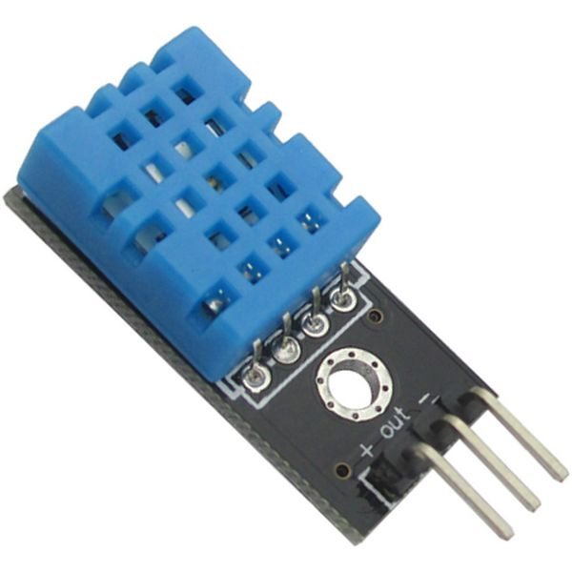
Hardware: DHT11 Sensor
From ElectronicWings website:
The DHT11 is a basic, low cost digital temperature and humidity sensor. DHT11 is a single wire digital humidity and temperature sensor, which provides humidity and temperature values serially with one-wire protocol. DHT11 sensor provides relative humidity value in percentage (20 to 90% RH) and temperature values in degree Celsius (0 to 50 °C).
Datasheet: DHT11 Humidity & Temperature Sensor (mouser.com)
In our design, we utilize the DHT11 to collect both humidity and temperature measurements. At default, the DHT11 serially sends data in celsius for the temperature and a percentage for the humidity. Our design polls for the data measurements, but to reduce the amount of data sent via UART, we made a condition to only print when the data has changed.

Slide 5
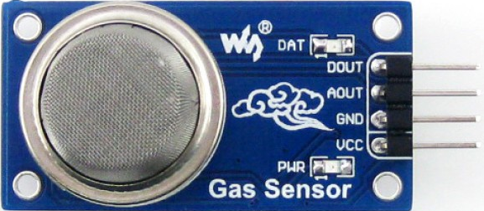
Hardware: MQ-135 Sensor
From Elprocus’ website:
[The MQ135 is] A device that is used to detect, measure, or monitor gases like ammonia, benzene, sulfur, carbon dioxide, smoke, and other harmful gases. If the concentration of gases exceeds the threshold limit in the air, then the digital output pin goes high. The analog output voltage is obtained from the analog pin of the sensor, which gives the approximate value of the gas level present in the air.
Datasheet:
Use introduction of HS-129 type gas sensitive components (olimex.com)
In our design, the MQ135 is used to detect harmful gases within the air. However, given we will be conducting on school grounds, we will only be testing this device with smoke and (if manageable) high levels of CO2. Similar to the DHT11, the polled data will be displayed on the condition of data change from the sensor.

Slide 6
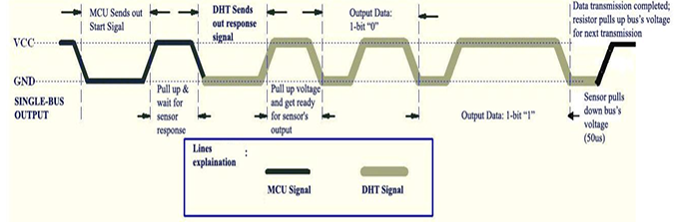
Project: Coding
void Request(){ // Microcontroller send start //pulse/request DDRB |= (1<<DHT11_PIN); PORTB &= ~(1<<DHT11_PIN); // set to low pin _delay_ms(20); // wait for 20ms PORTB |= (1<<DHT11_PIN); //set to high pin }

Slide 7
Project: Coding
void Response() // receive response from DHT11 { DDRB &= ~(1<<DHT11_PIN); while(PINB & (1<<DHT11_PIN)); while((PINB & (1<<DHT11_PIN))==0); while(PINB & (1<<DHT11_PIN)); }

Slide 8
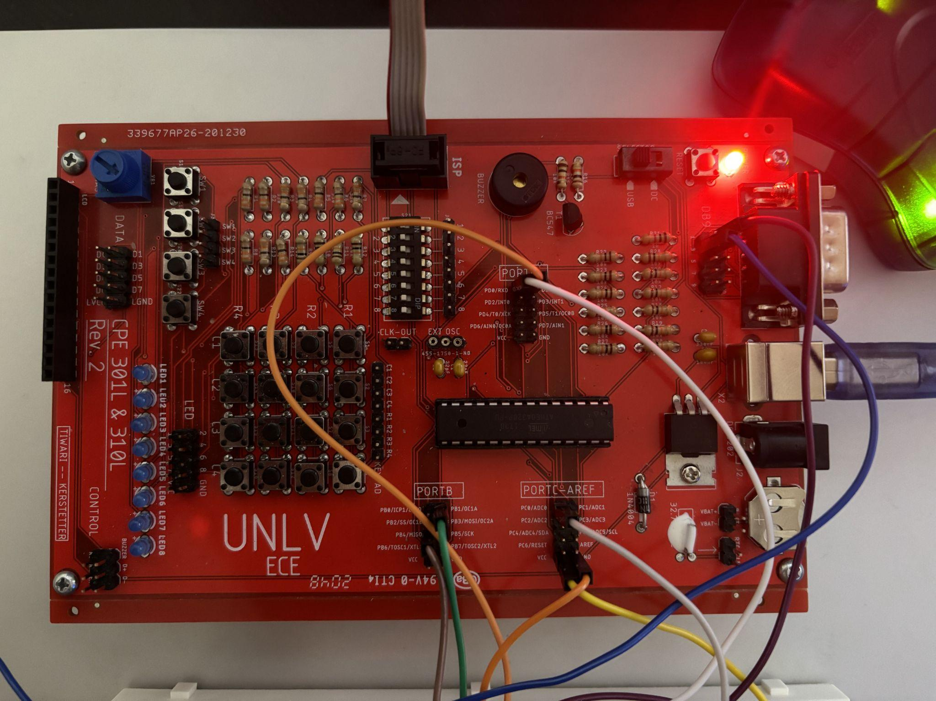
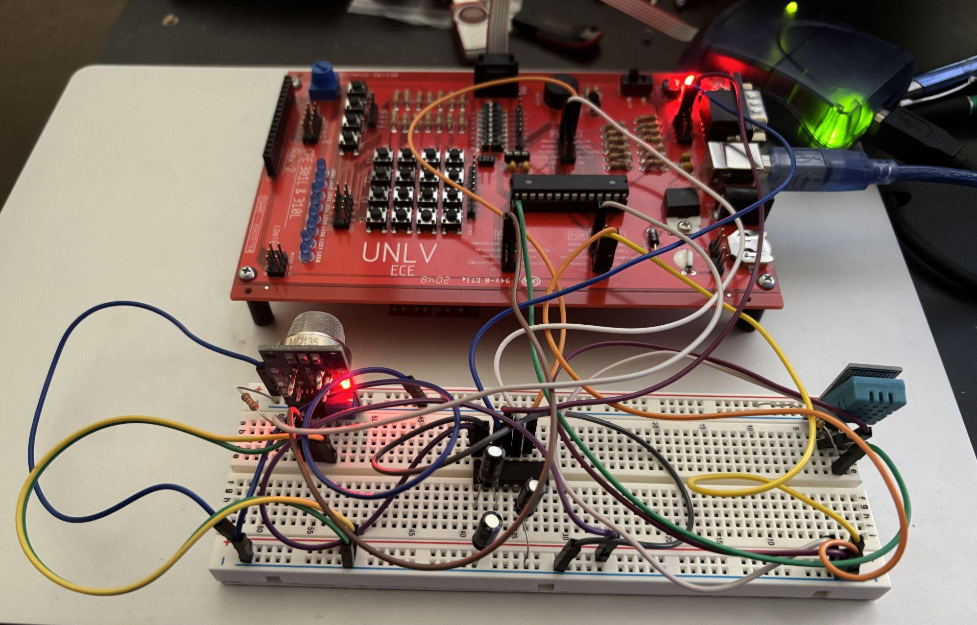
Project: Board and Wiring

Slide 9
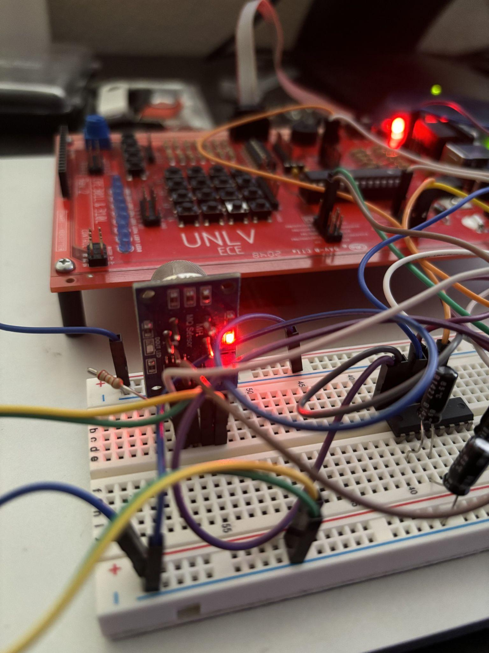
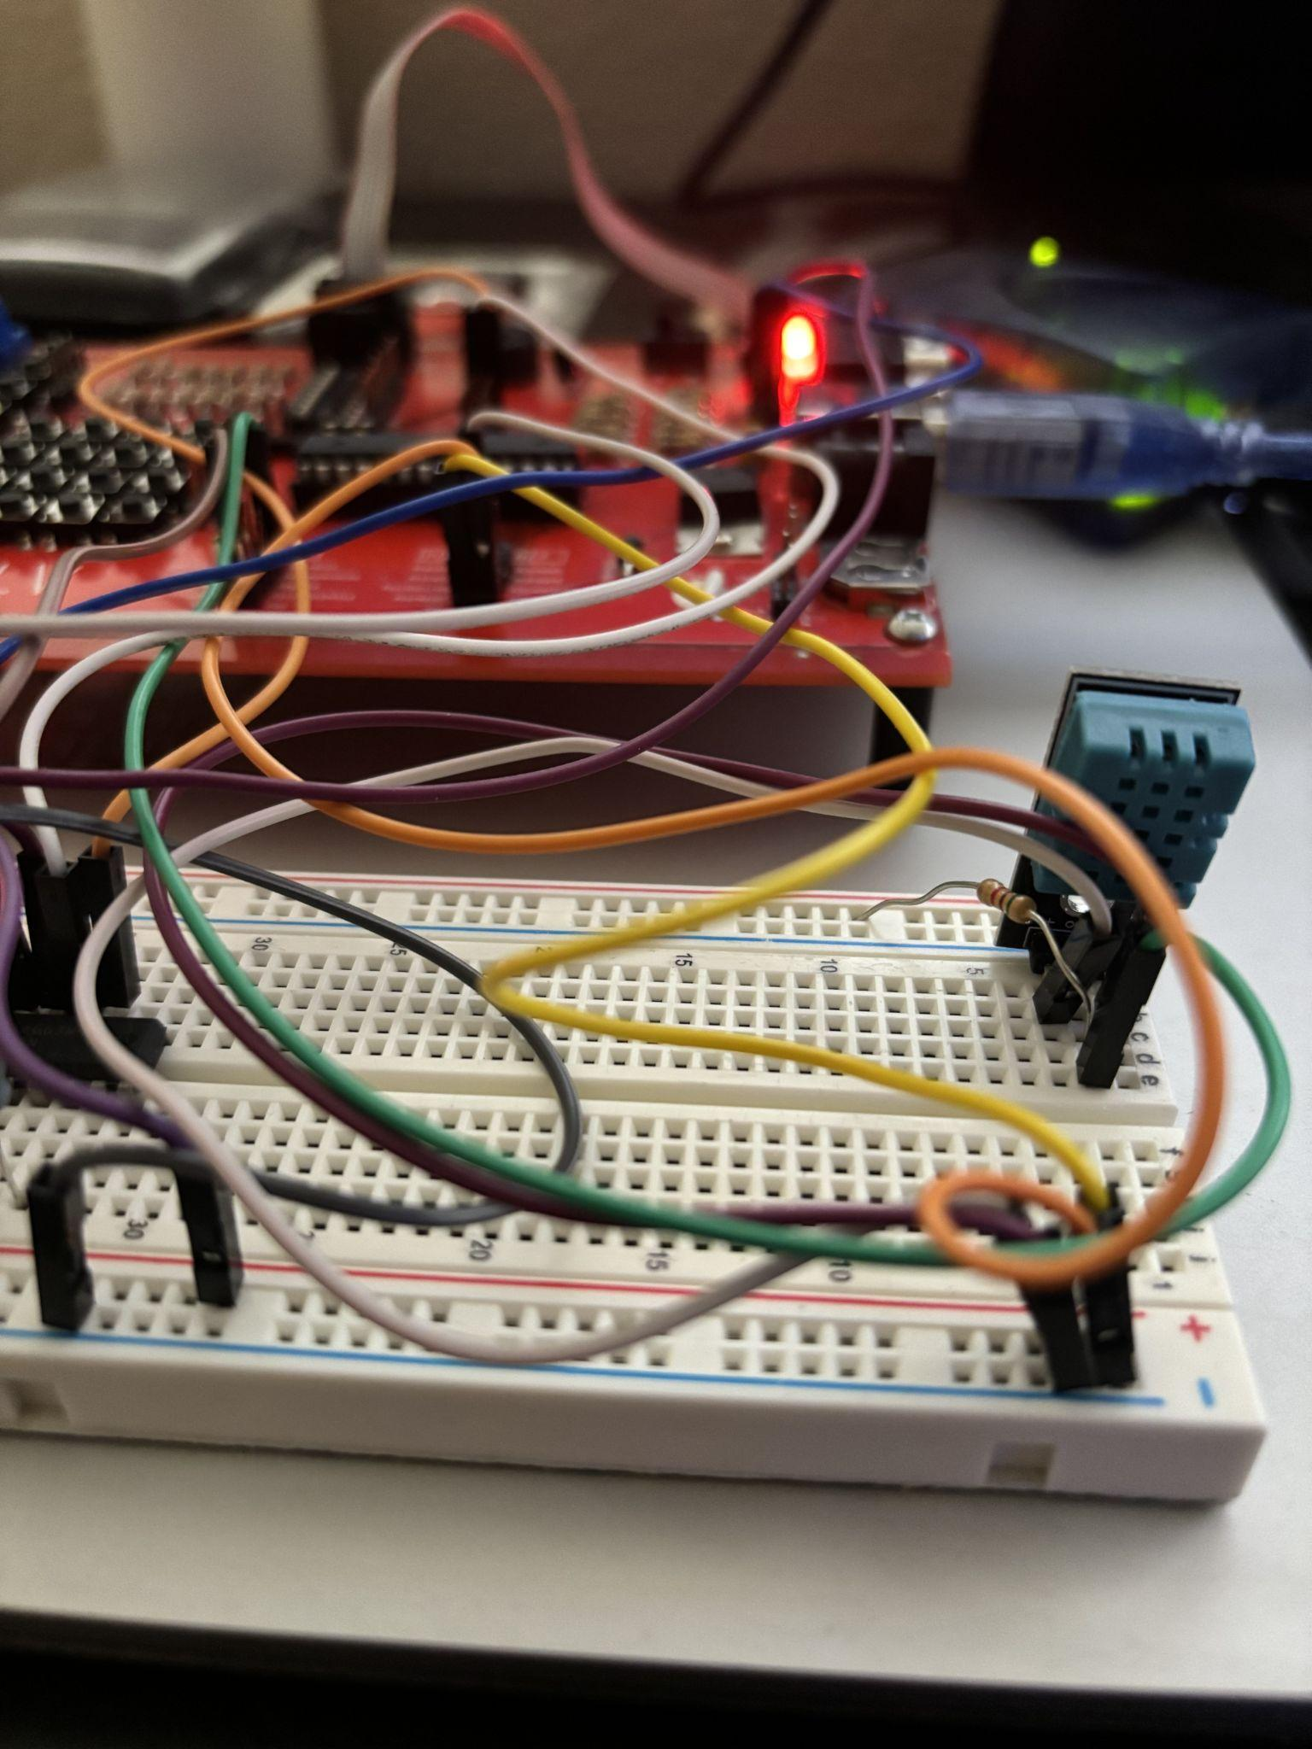
Project: Board and Wiring
MQ135
DHT11

Slide 10
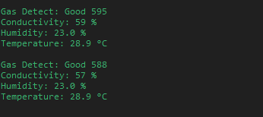
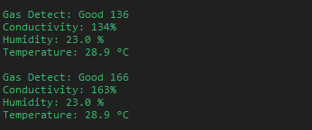
Project: Results
For testing the DHT11, we can simply hold the sensor with our hands and using our body heat/ sweat to detect a change in temperature and humidity.
For testing the MQ135, we used drinking alcohol to detect gas in the air. While the sensor is used for detecting gases, it can also detect alcohol and smoke from within the air.
To the left is the result of testing the MQ135 with the top and bottom image being the before and after exposure to alcohol.

Slide 11
Project: Issues and Final Comments
Though the MQ135 can indicate the type of chemical or compound within the air, we discovered that it is not accurate. We initially wanted to detect and indicate which gas that the sensor is detecting, however, the data will vary depending on the temperature, humidity, and R load in the circuit.
In addition, we had issues with indicating when the air quality is good, moderate, or poor. Though we can visually see the data changing and entering the different boundaries, the result will always say that the air quality is good.
Granted that we are constantly polling for data, it takes a considerable amount of time for data to be transmitted through the UART. For instance, with the DHT11 sensor, it can take up to 10 seconds for an update in temperature change.
ADC, UART, INTERRUPTS, POLLING, DHT11, MQ-135

Slide 12
THANK YOU!

Slide 13
Works Cited
ATMEGA328P | Microchip Technology
https://cdn.shopify.com/s/files/1/0300/6424/6919/files/DHT11_Sensor_Pinout_600x600.jpg?v=1586925043
https://th.bing.com/th/id/R.0add2d15774935c57869cdffaaad773a?rik=qRMln5CePPn8IQ&pid=ImgRaw&r=0
https://www.inventelectronics.com/wp-content/uploads/2017/03/dht11-01.jpg
https://www.waveshare.com/media/catalog/product/cache/1/image/800x800/9df78eab33525d08d6e5fb8d27136e95/m/q/mq-135-gas-sensor-3_5.jpg

